Slide 1
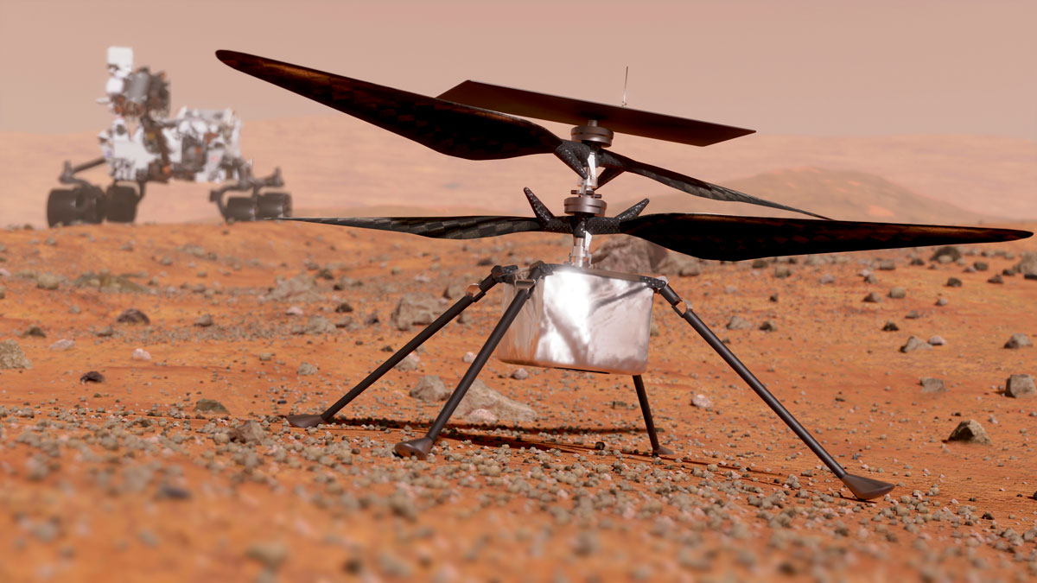
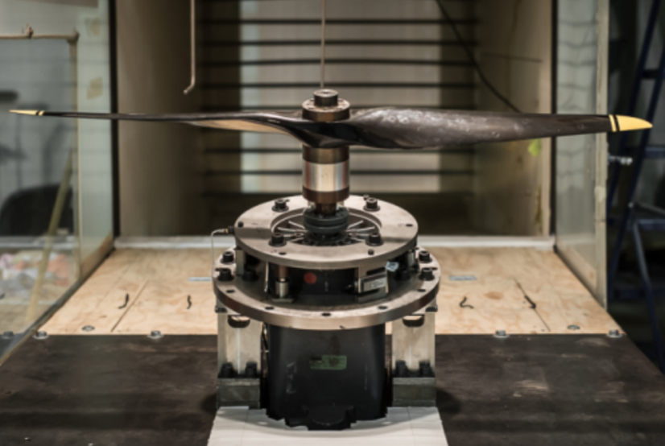
Advancing Aerodynamics: Coupled Airfoil and Rotor Performance Optimization for Mars Applications
Witold J. F. Koning¹, B. Natalia Perez Perez¹, Haley V. Cummings², Ethan A. Romander²
and Wayne Johnson²
¹Science and Technology Corp., NASA Ames Research Center, Moffett Field, CA
²NASA Ames Research Center, Moffett Field, CA
2025 AIAA SciTech Forum, Orlando, Florida, 6 - 10 January 2025
AIAA-JSASS Joint Session: Martian Aerodynamics
Notes:
This session will be held as one of the two joint sessions of AIAA and the Japan Society for Aeronautical and Space Sciences (JSASS). Presentations will be given from both AIAA and JSASS. This session will focus on aerodynamics in the Mars environment. This joint session was started at 2018 in Japan, and the second joint sessions were held at the 2020 AIAA SciTech Forum. This is the 3rd joint sessions of AIAA-JSASS.

Slide 2

Goal
“Provide the methodology to optimize unconventional airfoils and use them effectively to optimize rotor hover performance at Mars conditions.”

Slide 3
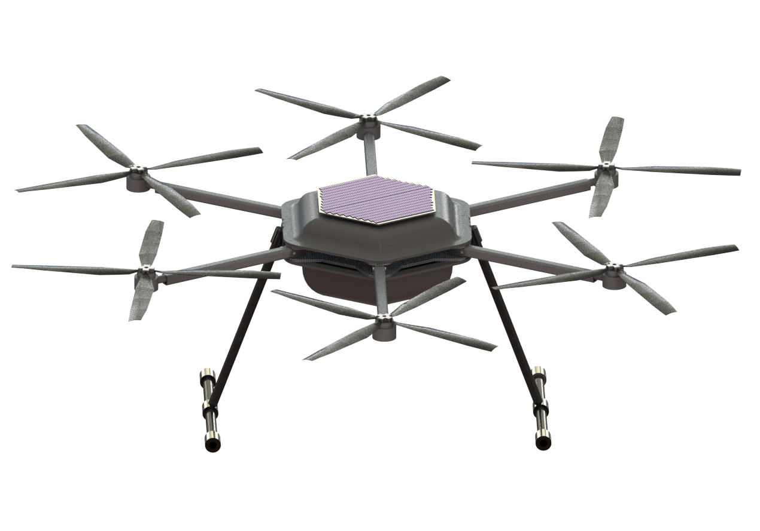
Outline
High-subsonic, Low Reynolds Number Conditions
The ELISA Optimization Toolset
  High-level Overview
  Airfoil Parameterization and Optimization
  Rotor Optimization
Conclusions
Future Work
Mars Science Helicopter
(MSH) hexacopter

Slide 4
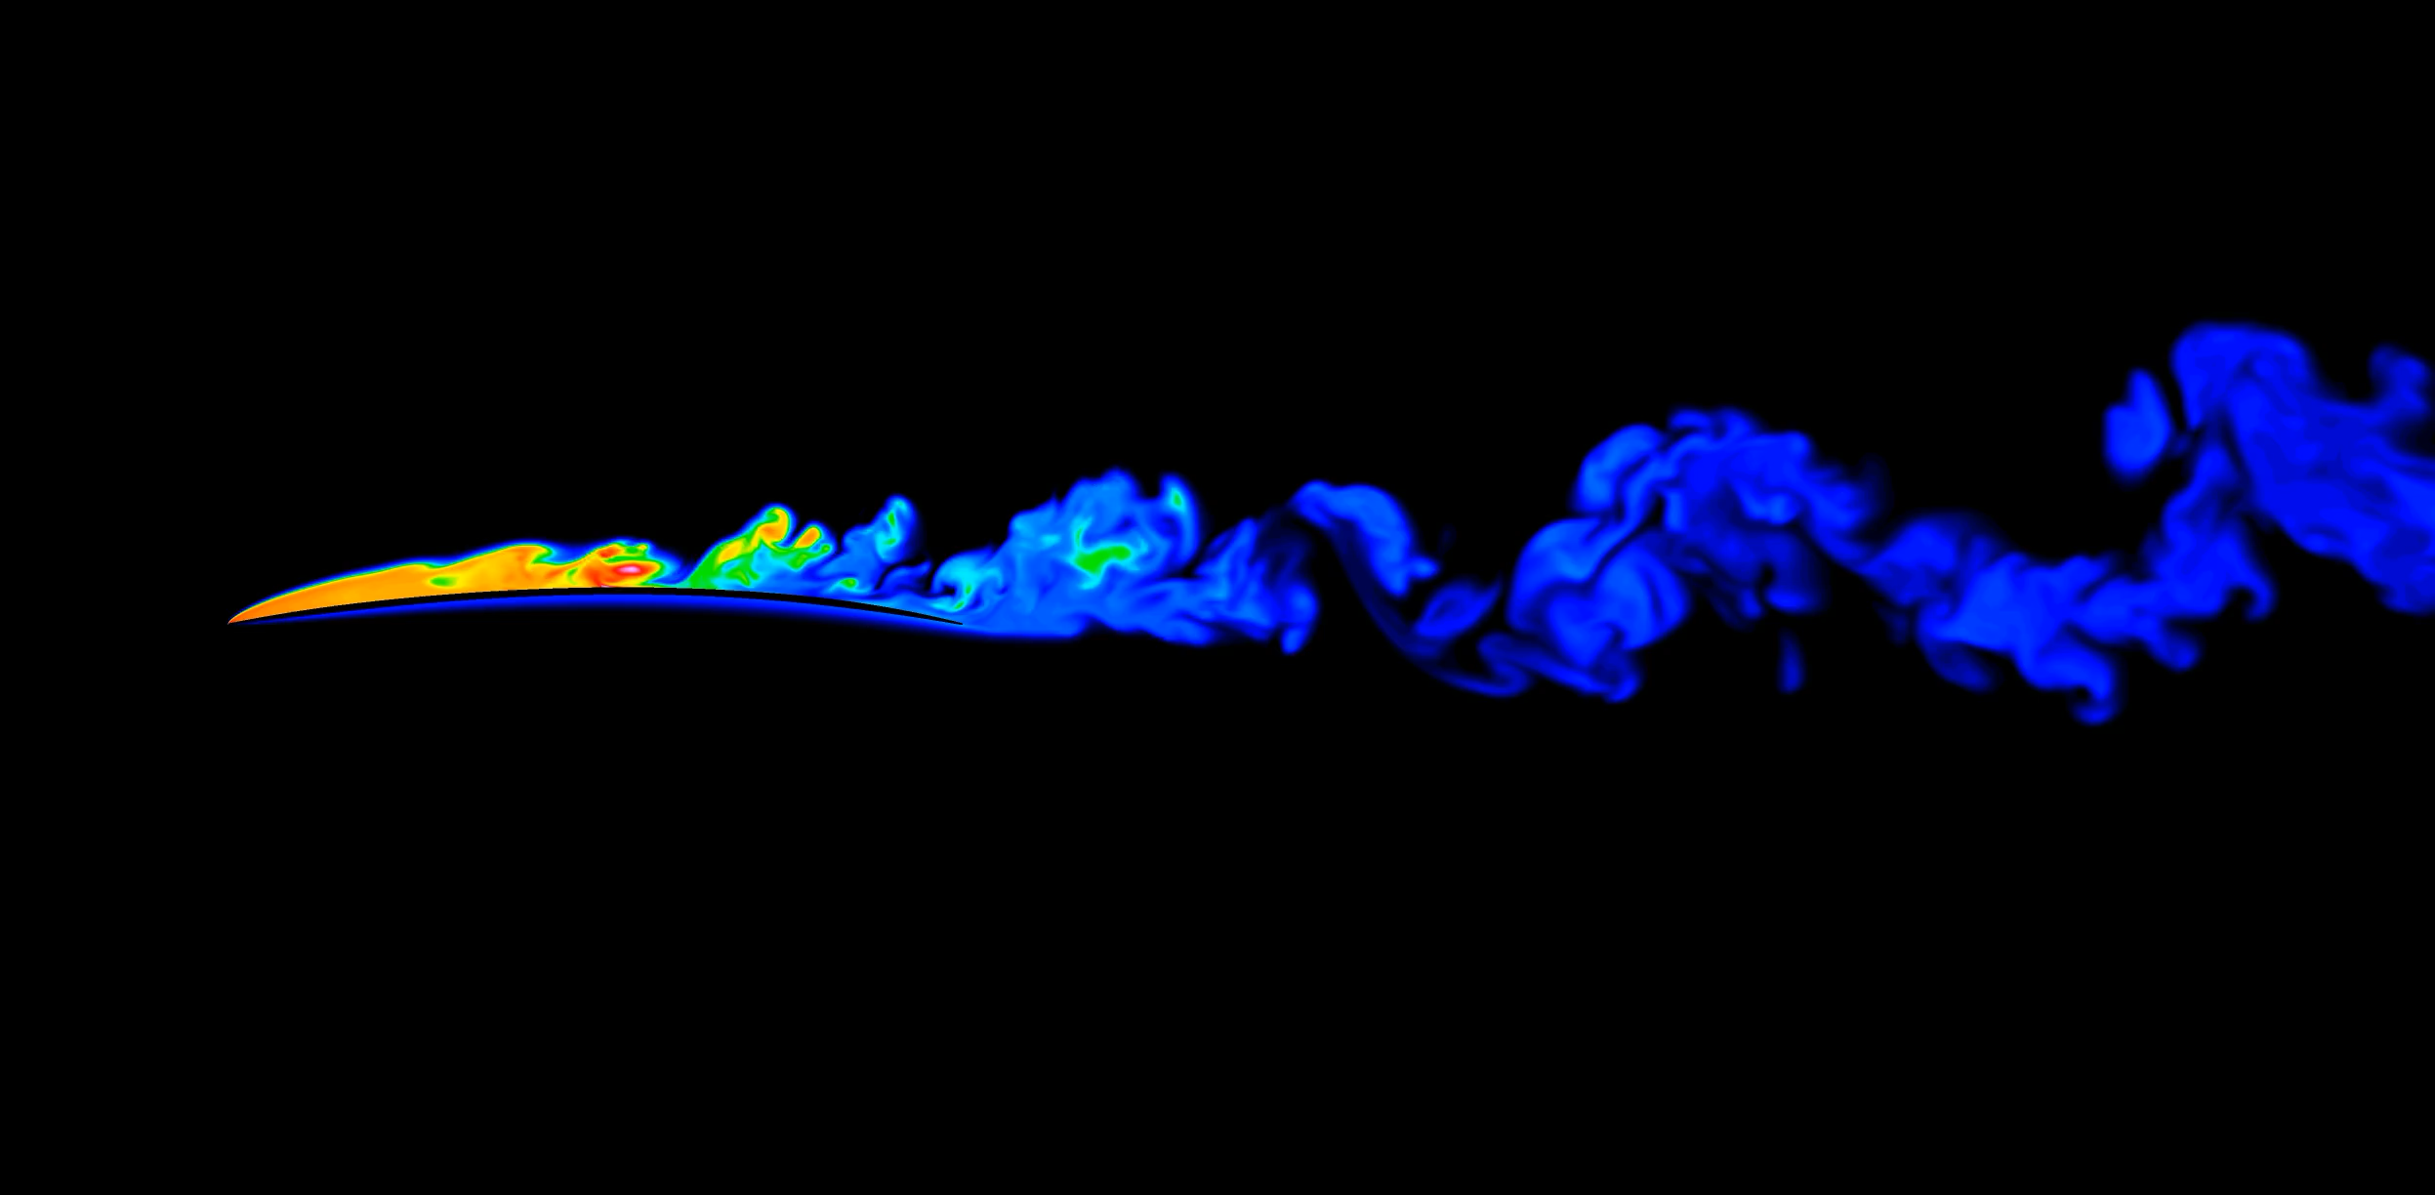
High-subsonic, Low Reynolds Number
Density ρ ≈ 0.017 kg/m³
M_{tip} = 0.80
Reynolds number r/R = 0.75 and Re = 20,000
Most available low Re research at Re > 100,000 and M < 0.30
V∞
airfoil
roamx-0201 type airfoil at Re = 20,000, M = 0.60, α = 6 degrees

Slide 5
ELISA: High-level Overview
The Evolutionary aLgorithm for Iterative Studies of Aeromechanics (ELISA)
Dual consecutive Genetic Algorithms (GA) to perform sequential airfoil and rotor optimization
  Airfoil optimization (section performance, OVERFLOW)
  Rotor optimization (hover performance, CAMRAD II)
    Linking the collection of optimal airfoils (as function of angle of attack) to the rotor optimization
Notes:
Koning, W., Perez Perez, N., Cummings, H., Romander, E., Johnson, W., "ELISA: A Tool for Optimization of Rotor Hover Performance at Low Reynolds Number in the Mars Atmosphere," Journal of the American Helicopter Society, Volume 69, Number 4, October 2024, pp. 1-15(15).
https://rotorcraft.arc.nasa.gov/Publications/files/Koning_ELISA_JAHS.pdf

Slide 6
ELISA: High-level Overview
Multi-objective optimization with variety of objective choices
  Up to three-objectives simultaneously
  Airfoils: lift, drag, thickness ratio, (Reynolds number)
  Rotors: blade loading, rotor power, (density)
Notes:
Koning, W., Perez Perez, N., Cummings, H., Romander, E., Johnson, W., "ELISA: A Tool for Optimization of Rotor Hover Performance at Low Reynolds Number in the Mars Atmosphere," Journal of the American Helicopter Society, Volume 69, Number 4, October 2024, pp. 1-15(15).
https://rotorcraft.arc.nasa.gov/Publications/files/Koning_ELISA_JAHS.pdf

Slide 7
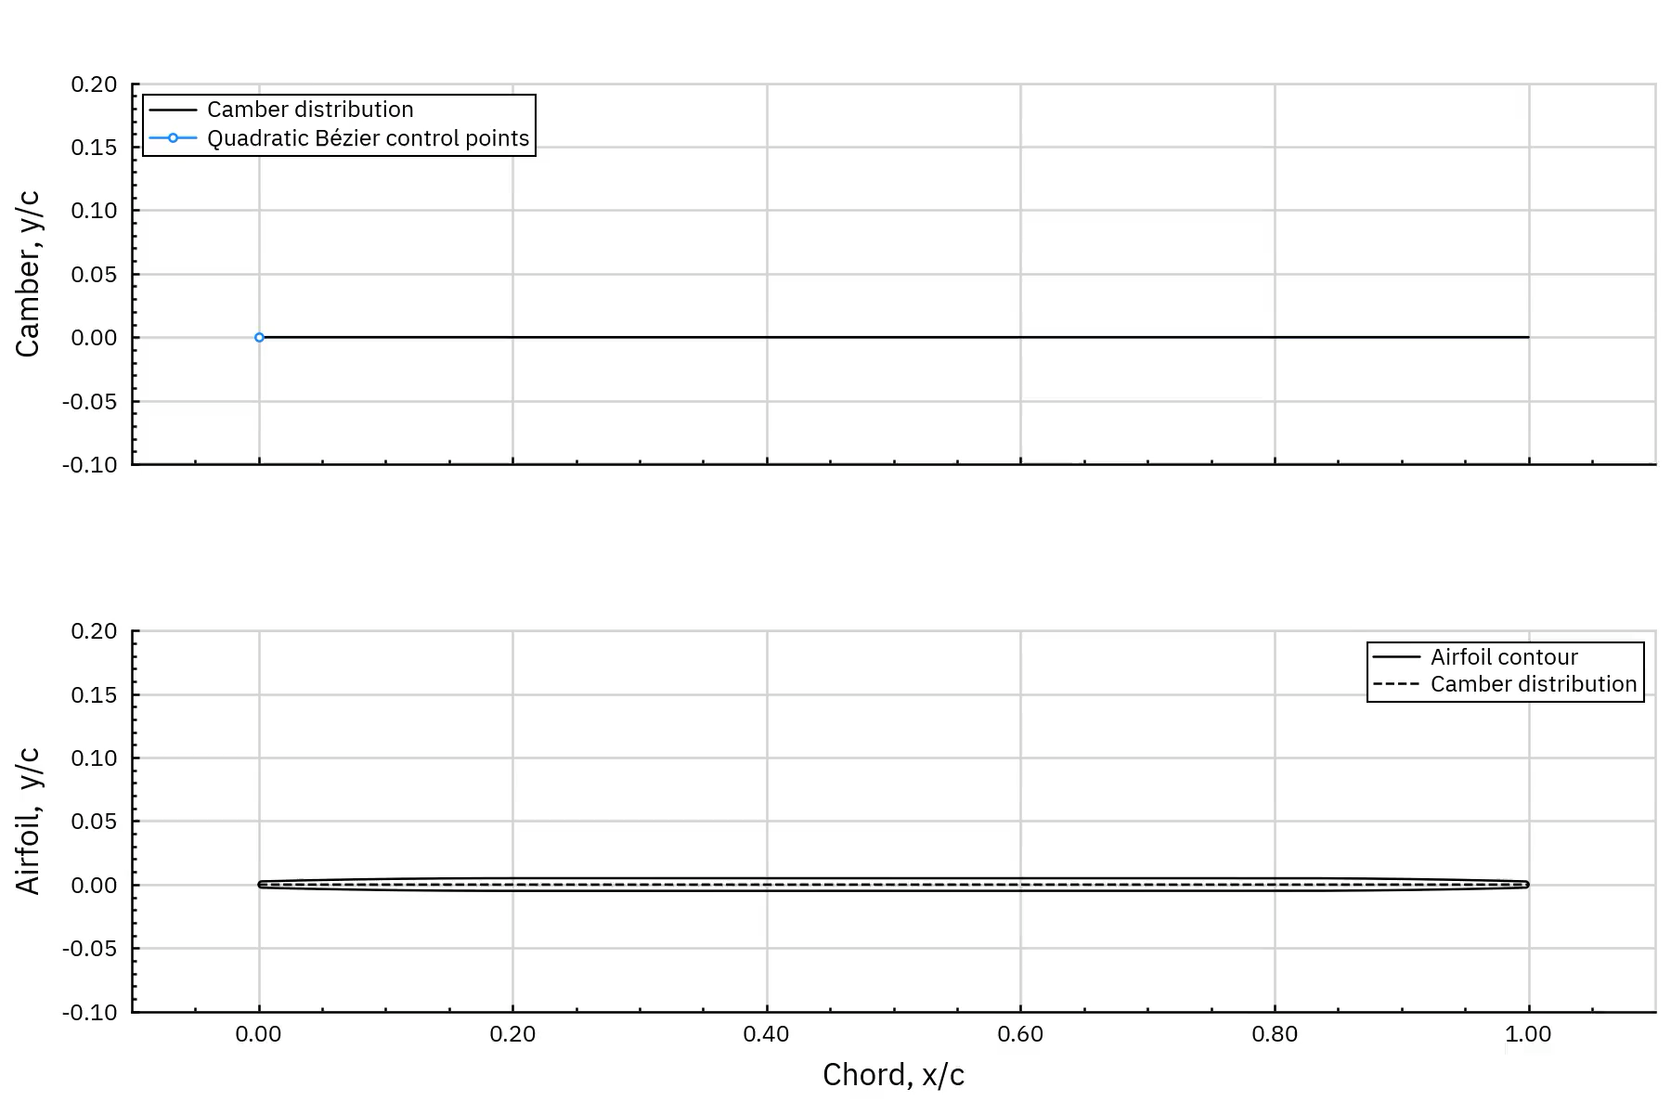
ELISA: roamx Airfoil Parameterization
Notes:
Koning, W., Perez Perez, N., Cummings, H., Romander, E., Johnson, W., "ELISA: A Tool for Optimization of Rotor Hover Performance at Low Reynolds Number in the Mars Atmosphere," Journal of the American Helicopter Society, Volume 69, Number 4, October 2024, pp. 1-15(15).
https://rotorcraft.arc.nasa.gov/Publications/files/Koning_ELISA_JAHS.pdf

Slide 8
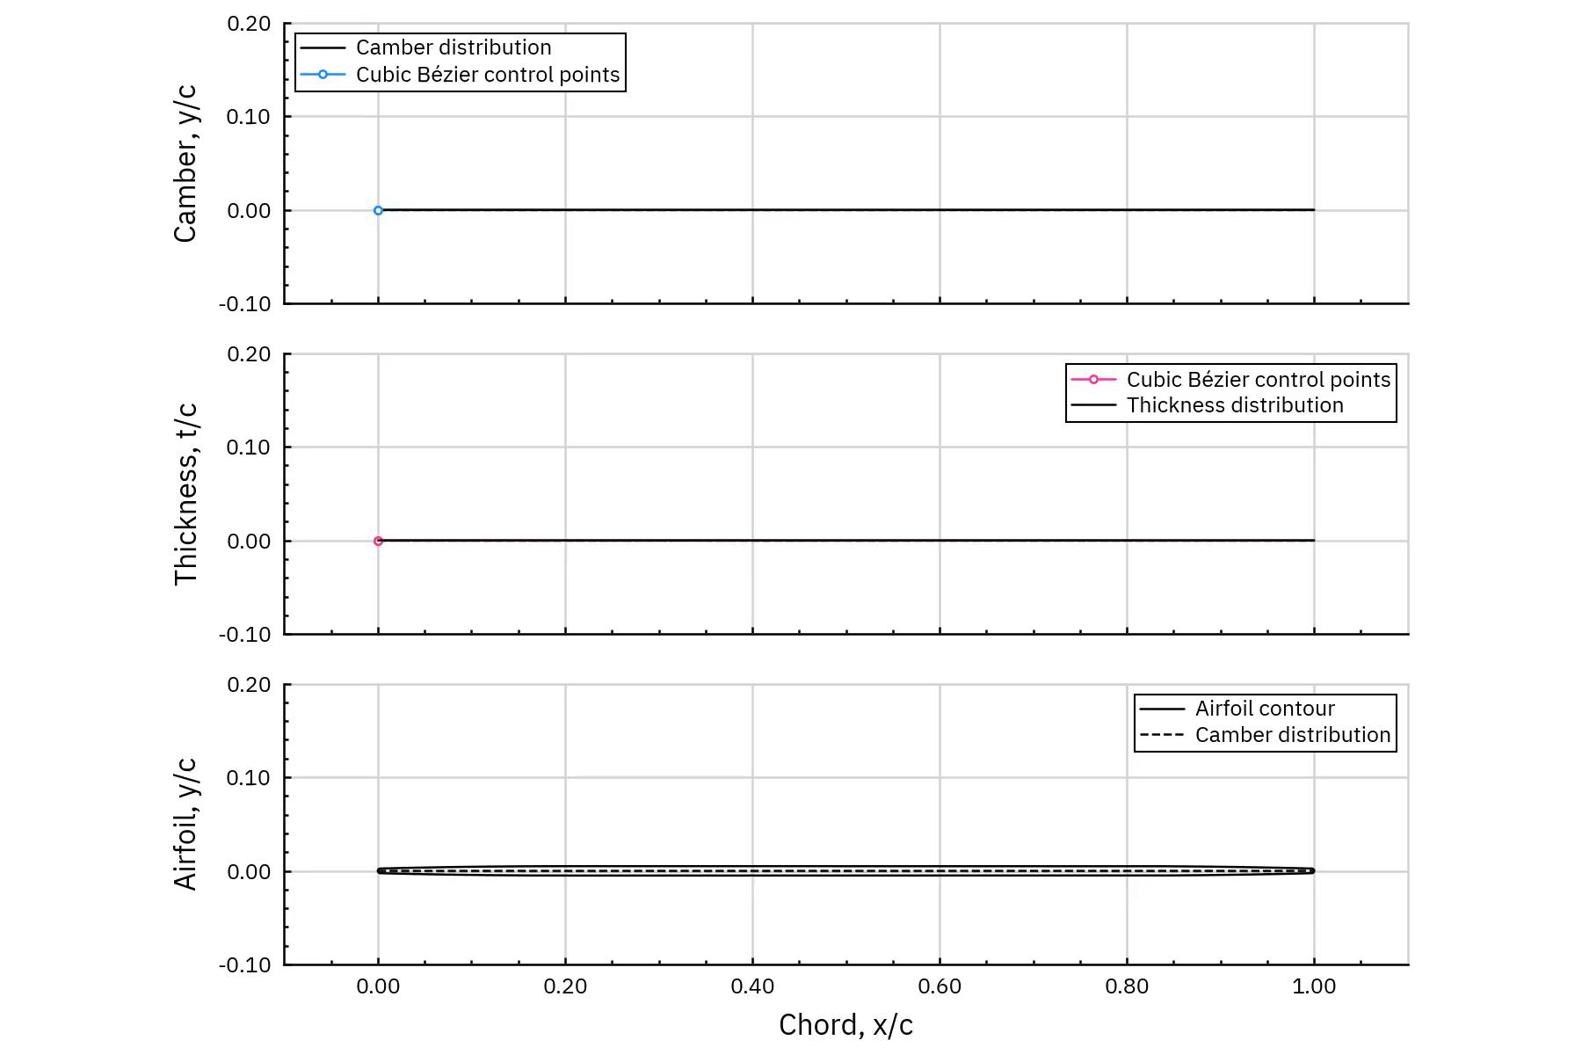
ELISA: roamx Airfoil Parameterization
Notes:
Koning, W., Perez Perez, N., Cummings, H., Romander, E., Johnson, W., "ELISA: A Tool for Optimization of Rotor Hover Performance at Low Reynolds Number in the Mars Atmosphere," Journal of the American Helicopter Society, Volume 69, Number 4, October 2024, pp. 1-15(15).
https://rotorcraft.arc.nasa.gov/Publications/files/Koning_ELISA_JAHS.pdf

Slide 9
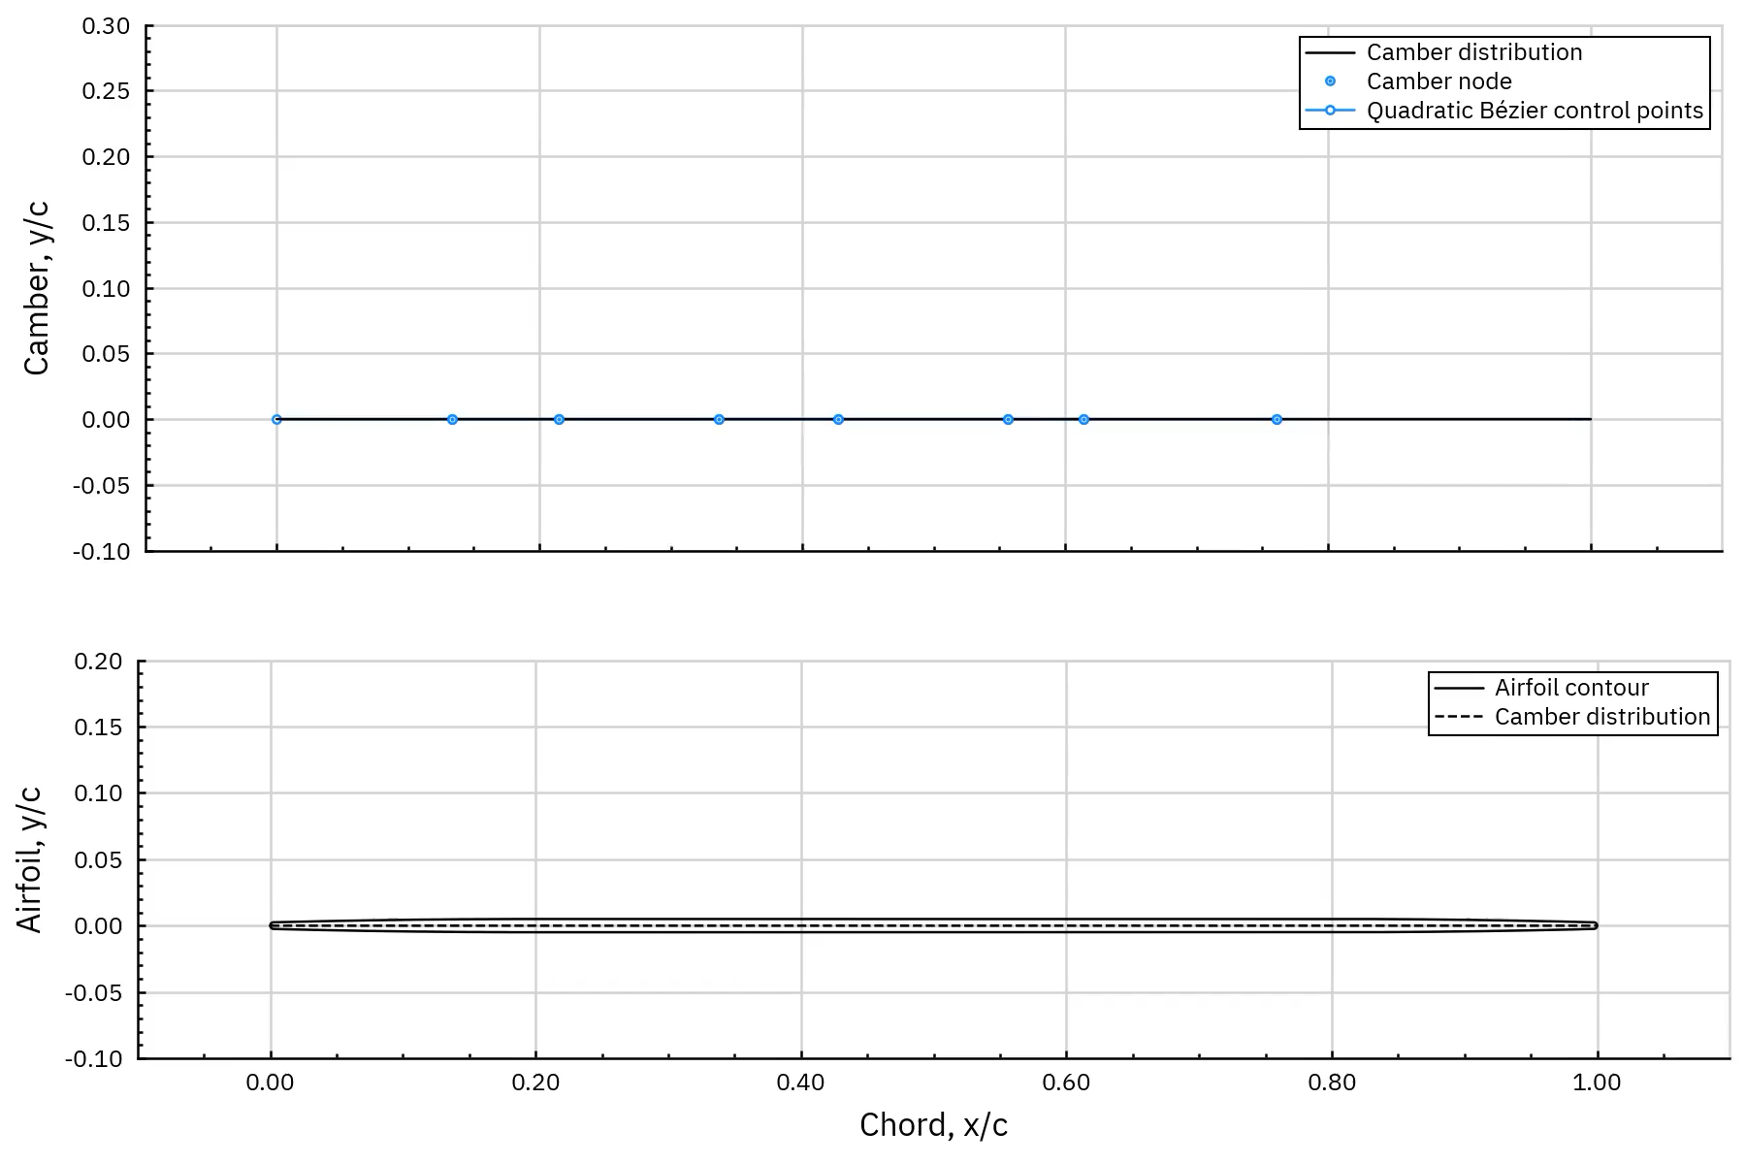
ELISA: roamx Airfoil Parameterization
Notes:
Koning, W., Perez Perez, N., Cummings, H., Romander, E., Johnson, W., "ELISA: A Tool for Optimization of Rotor Hover Performance at Low Reynolds Number in the Mars Atmosphere," Journal of the American Helicopter Society, Volume 69, Number 4, October 2024, pp. 1-15(15).
https://rotorcraft.arc.nasa.gov/Publications/files/Koning_ELISA_JAHS.pdf

Slide 10
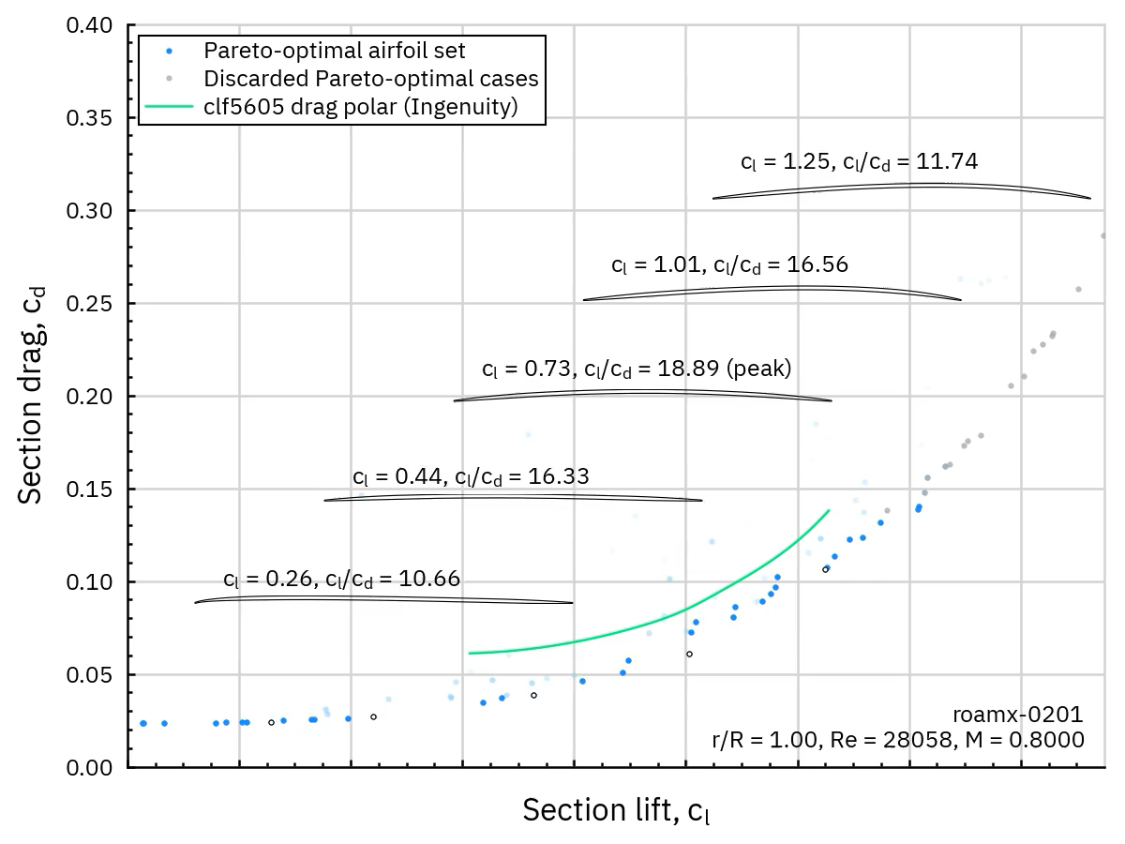
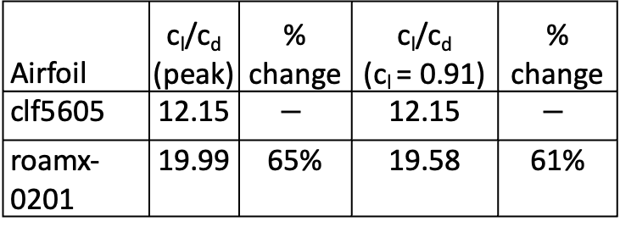
Airfoil Optimization
Airfoil | c_{l}/c_{d} (peak) | % change | c_{l}/c_{d} (c_{l} = 0.91) | % change
clf5605 | 12.15 | $$−$$ | 12.15 | $$−$$
roamx- 0201 | 19.99 | 65% | 19.58 | 61%
Notes:
Koning, W., Perez Perez, N., Cummings, H., Romander, E., Johnson, W., "ELISA: A Tool for Optimization of Rotor Hover Performance at Low Reynolds Number in the Mars Atmosphere," Journal of the American Helicopter Society, Volume 69, Number 4, October 2024, pp. 1-15(15).
https://rotorcraft.arc.nasa.gov/Publications/files/Koning_ELISA_JAHS.pdf

Slide 11
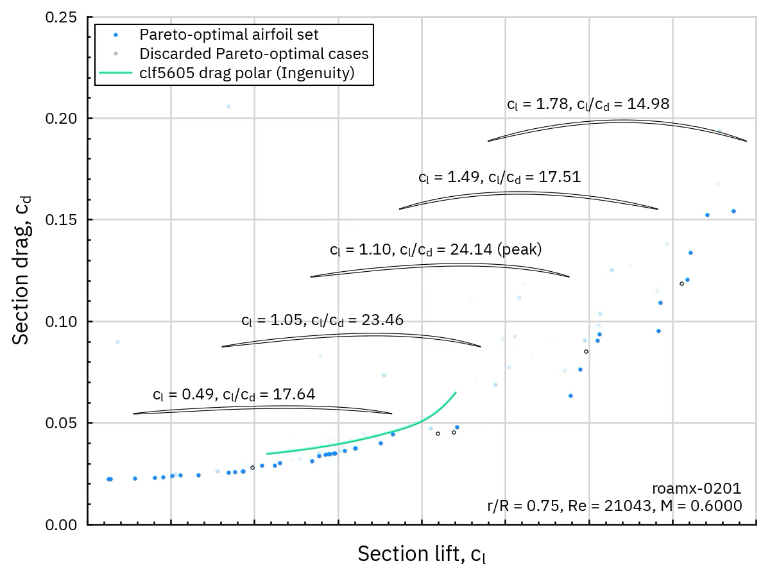
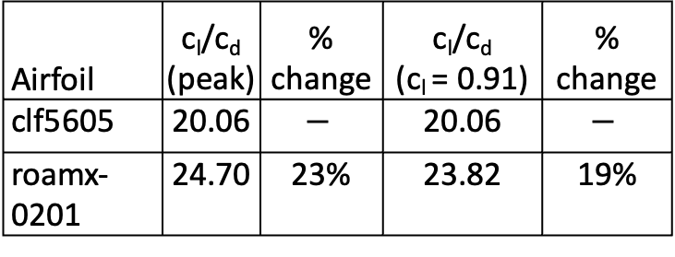
Airfoil Optimization
Airfoil | c_{l}/c_{d} (peak) | % change | c_{l}/c_{d} (c_{l} = 0.91) | % change
clf5605 | 20.06 | $$−$$ | 20.06 | $$−$$
roamx- 0201 | 24.70 | 23% | 23.82 | 19%
Notes:
Koning, W., Perez Perez, N., Cummings, H., Romander, E., Johnson, W., "ELISA: A Tool for Optimization of Rotor Hover Performance at Low Reynolds Number in the Mars Atmosphere," Journal of the American Helicopter Society, Volume 69, Number 4, October 2024, pp. 1-15(15).
https://rotorcraft.arc.nasa.gov/Publications/files/Koning_ELISA_JAHS.pdf

Slide 12
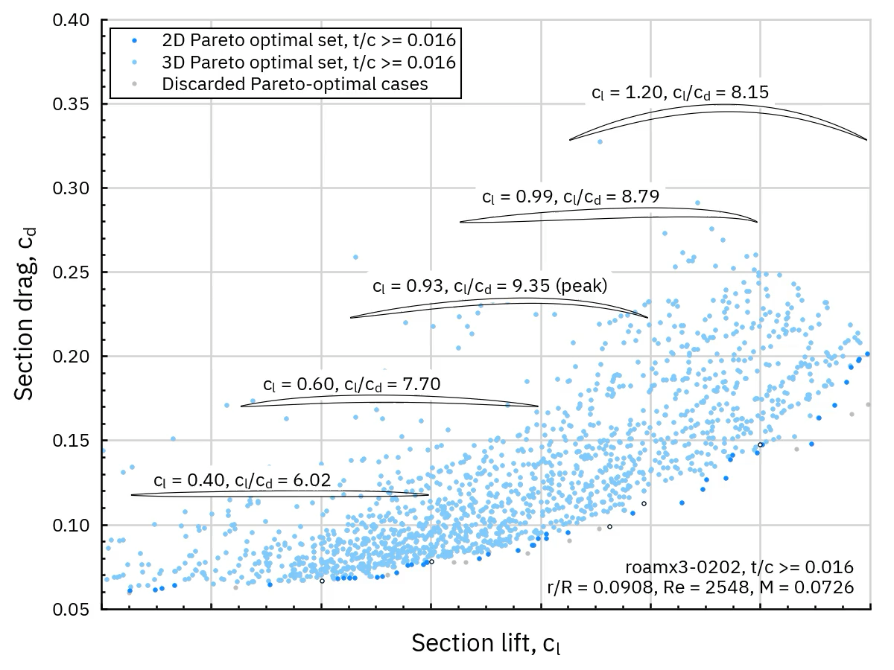
Airfoil Optimization
Notes:
Koning, W., Perez Perez, N., Cummings, H., Romander, E., Johnson, W., "ELISA: A Tool for Optimization of Rotor Hover Performance at Low Reynolds Number in the Mars Atmosphere," Journal of the American Helicopter Society, Volume 69, Number 4, October 2024, pp. 1-15(15).
https://rotorcraft.arc.nasa.gov/Publications/files/Koning_ELISA_JAHS.pdf

Slide 13
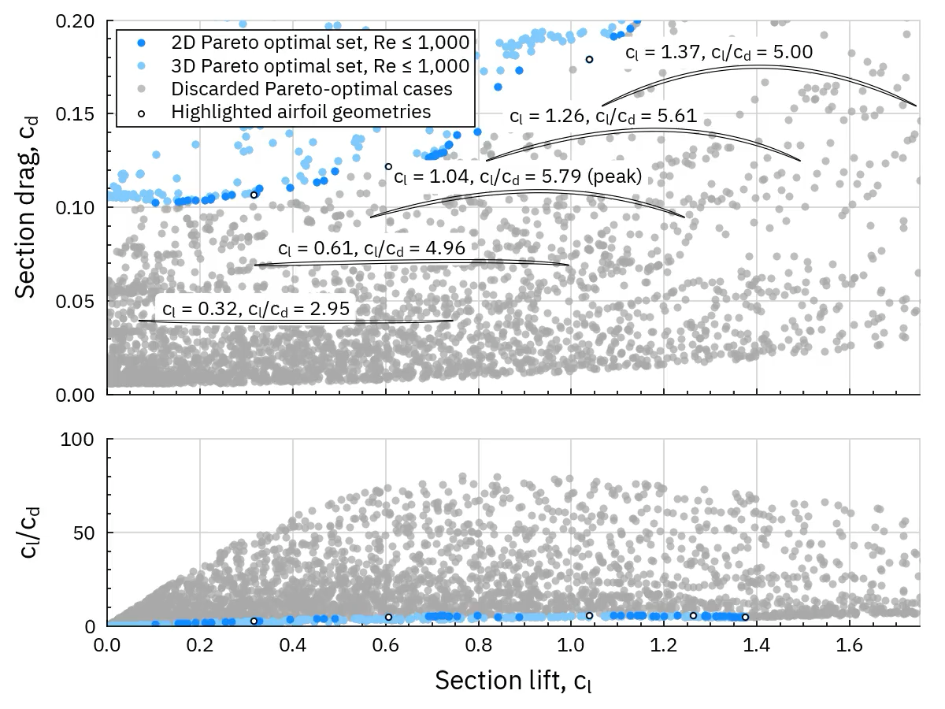
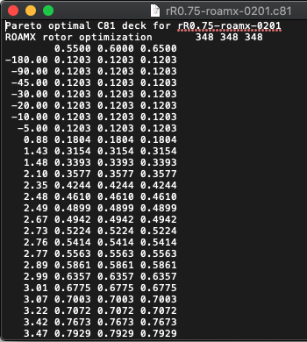
Airfoil Optimization
Pareto optimal set and airfoil geometry
  Coupling of Pareto front to Pareto-optimal airfoil decks
Notes:
Koning, W., Perez Perez, N., Cummings, H., Romander, E., Johnson, W., "Overview of Rotor Hover Performance Capabilities at Low Reynolds Number for Mars Exploration," 50th European Rotorcraft Forum, Marseille, France 2024.
https://rotorcraft.arc.nasa.gov/Publications/files/Koning_France_2024.pdf

Slide 14
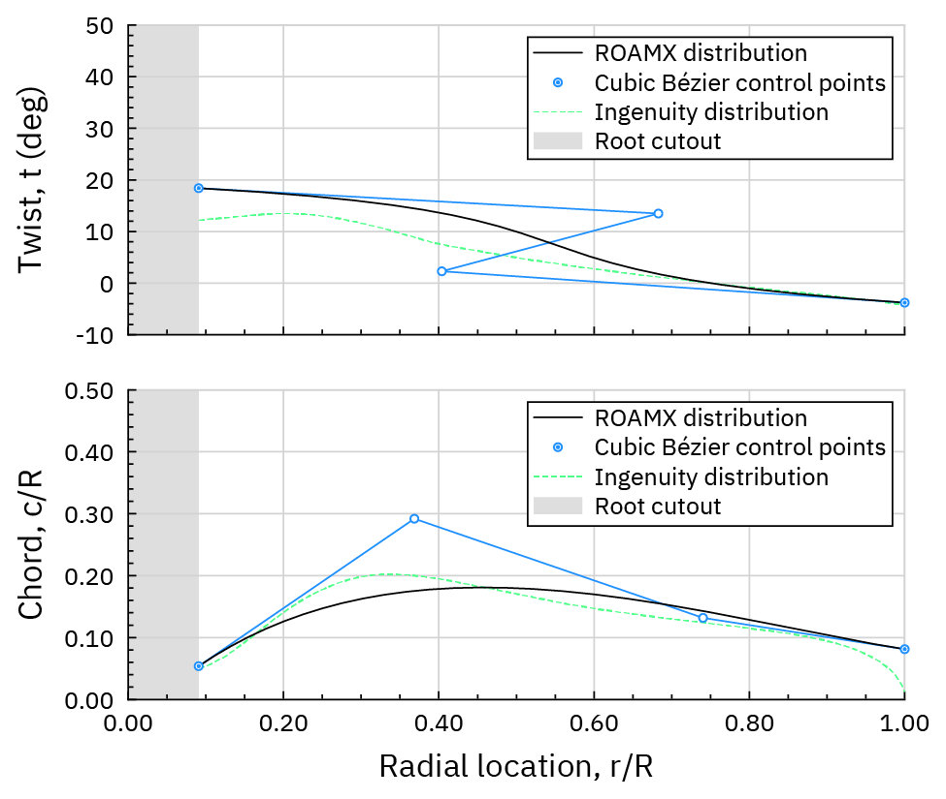
Rotor Parameterization
Cubic Bézier curve for twist and planform
Notes:
Koning, W., Perez Perez, N., Cummings, H., Romander, E., Johnson, W., "ELISA: A Tool for Optimization of Rotor Hover Performance at Low Reynolds Number in the Mars Atmosphere," Journal of the American Helicopter Society, Volume 69, Number 4, October 2024, pp. 1-15(15).
https://rotorcraft.arc.nasa.gov/Publications/files/Koning_ELISA_JAHS.pdf

Slide 15
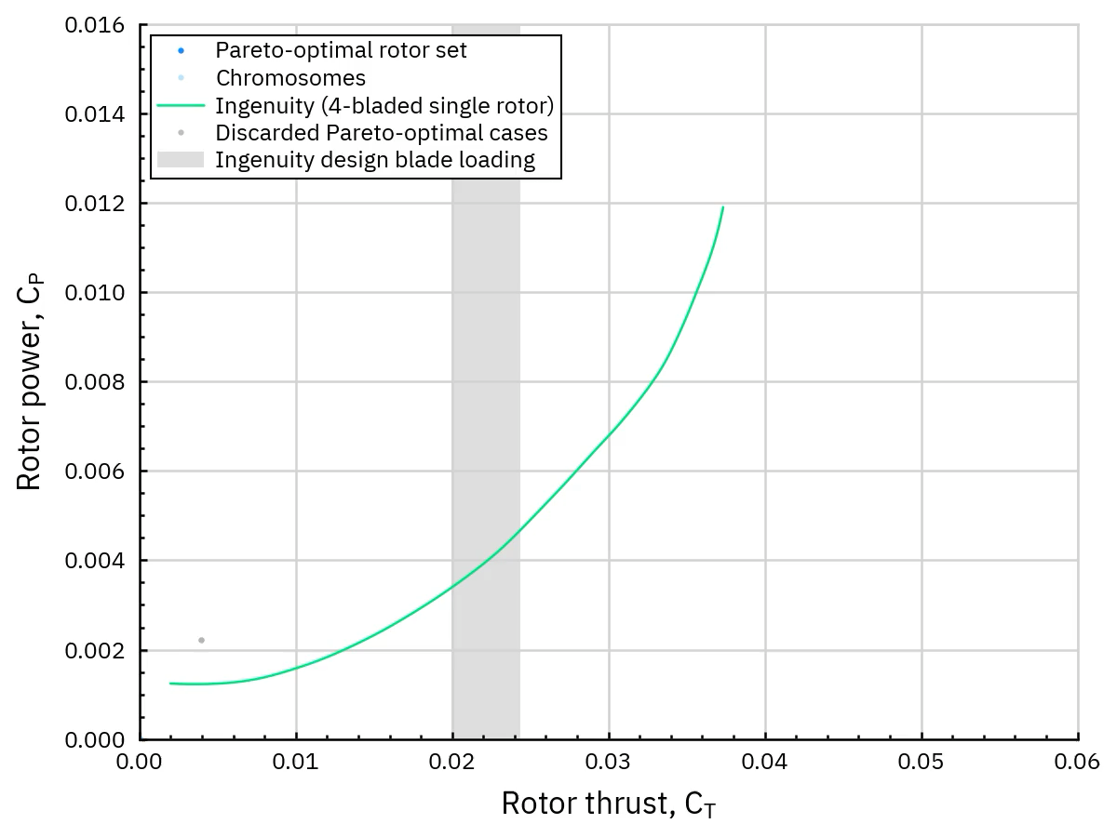
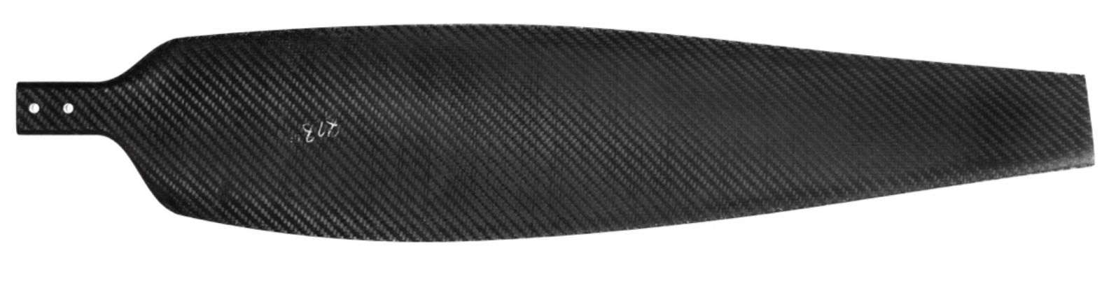
Rotor Optimization
ROAMX rotor optimization
  Dual objective:
    max. blade loading
    min. rotor power
  6-bladed single rotor
  σ_{tw} = 0.25
Compared to Ingenuity modeled as single rotor
  CAMRADII predictions using same CFD approach in OVERFLOW
Notes:
Koning, W., Perez Perez, N., Cummings, H., Romander, E., Johnson, W., "ELISA: A Tool for Optimization of Rotor Hover Performance at Low Reynolds Number in the Mars Atmosphere," Journal of the American Helicopter Society, Volume 69, Number 4, October 2024, pp. 1-15(15).
https://rotorcraft.arc.nasa.gov/Publications/files/Koning_ELISA_JAHS.pdf

Slide 16
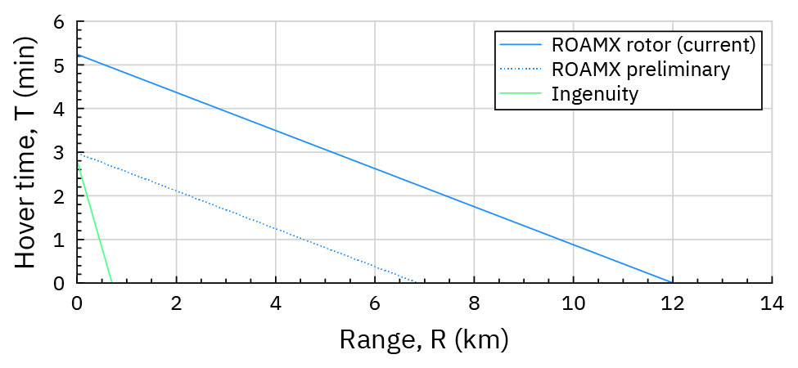
Vehicle Performance
NDARC performance estimates (ρ = 0.017 kg/m³, ‘Mars Condition 2’)
For Ingenuity-sized vehicle
ELISA used for Mars Science Helicopter, Sample Recovery Helicopter
Notes:
Koning, W., Perez Perez, N., Cummings, H., Romander, E., Johnson, W., "ELISA: A Tool for Optimization of Rotor Hover Performance at Low Reynolds Number in the Mars Atmosphere," Journal of the American Helicopter Society, Volume 69, Number 4, October 2024, pp. 1-15(15).
https://rotorcraft.arc.nasa.gov/Publications/files/Koning_ELISA_JAHS.pdf

Slide 17
Conclusions
Rotor optimization using the Evolutionary aLgorithm for Iterative Studies of Aeromechanics (ELISA) optimization toolset was demonstrated
  roamx airfoil parameterization
  Airfoil optimization for radial stations
  Rotor hover optimization

Slide 18
Future Work
High-fidelity 3D CFD validation
ROAMX experimental rotor testing
  Validation of fully optimized rotor using roamx-0201 airfoils, up to M_{tip} = 0.95
Optimization at very high rotor solidities
ELISA efficiency improvements
Integration of structural analyses within the ELISA optimization toolset
  Rotor optimization can be evaluated along a mass axis and elastic deformations can be fed back into the rotor optimization
  Blade frequency and strength targets can be evaluated
  Allows for forward flight optimization, and worthwhile to explore

Slide 19

The research of Witold J. F. Koning, B. Natalia Perez Perez, and Haley Cummings is made possible by the NASA FY21 Space Technology Mission. Directorate Early Career Initiative Project “Rotor Optimization for the Advancement of Mars eXploration.”
Lidia Caros, Oliver Buxton, and Peter Vincent of Imperial College, London, are thanked for helpful discussions and expertise.
Takayuki Nagata, Yudai Kanzaki, Miku Kasai, Muku Miyagi, Taku Nonomura and Keisuke Asai are thanked for their efforts and support.
Resources supporting this work were provided by the NASA High-End Computing Program through the NASA Advanced Supercomputing Division at Ames Research Center.

Slide 20
Thank you!

