Slide 1
UH-60A Airloads Wind Tunnel Data Update
Tom Norman
Airloads Workshop
Feb 28 – Mar 1, 2013

Slide 2
Outline
Current NASA Activities
Recent/Upcoming Airloads Publications
Data Storage Uncertainties
Recent Test Information
Section moment integration error
Mean lag comparisons with analysis

Slide 3
Current NASA Activities
Continuing data evaluation/reduction efforts for rotor data, Blade Displacement, PIV, and RBOS
Internal Govt meeting held Dec. 2012 to discuss data reduction status and future plans
Still have some work to do on data reduction process – work with CFD analysts providing valuable insights
Current goal to provide validated, accessible results for key points by early fall
Continuing evaluation of slowed-rotor data with CAMRAD
Continuing CFD validation efforts with both OVERFLOW and FUN3D

Slide 4
NASA Activities - OVERFLOW
Completed AIAA paper showing effects of wind tunnel and LRTA models on rotor loads and performance (Chang)
Continuing modeling in-board blade shank for better performance calculations (Romander/Lim)
Continuing comparisons between CFD and blade deflection measurements (Romander)
Performing computations for comparison with PIV measurements (Ahmad)

Slide 5
NASA Activities - FUN3D
Completed coupling of hi-res CAMRAD and RCAS with FUN3D
Completing thrust- and speed-sweep computations
With and without LRTA
Free air vs tunnel
Trim tab vs no trim tab
Performed computations for blade deflection pt (R42P60)
Compared airloads and pressures
Deflections yet to be examined

Slide 6
Recent/Upcoming Airloads Publications
January AIAA Mtg (2)
“Analysis of the UH-60A Rotor Loads Using Wind Tunnel Data”, Marpu et al
“Airloads Correlation of the UH- 60A Rotor Inside the 40- by 80- Foot Wind Tunnel”, Chang et al
AHS Forum (3)
“Wind Tunnel Measurements of the Wake of a Full-Scale UH-60A Rotor in Forward Flight”, Wadcock et al
“Retroreflective Background Oriented Schlieren of Tip Vortex Visualization and Mapping for UH-60 Airloads”, Schairer et al
“FUN3D Airload Predictions for the Full-Scale UH-60A Airloads Rotor in a Wind Tunnel”, Lee-Rausch et al
Summer AIAA Mtg (1)
“Comparison of Computed and Measured Vortex Evolution for a UH-60A Rotor in Forward Flight”, Ahmad et al

Slide 7
Data Storage Uncertainties
Selected wind tunnel data available to Workshop participants since Nov 2011 through NASA’s NSC Knowledge Now website
Nov 2012 hack of NSCKN site prompted NASA to alter its security approach
Starting April 2013, all NSCKN users must have a “NASA Identity” in order to access site
NASA Identify typically requires formal application, Govt background check, IT security training, etc
Looking for alternative method for data distribution (or streamlined NSCKN process)
Similar issue for distribution sites for OVERLOW and FUN3D

Slide 8
Section Moment Integration Error
Numerical integration scheme for wind tunnel section loads is equivalent to that used for UH-60A Airloads flight test
2nd order integration of pressures using mapped coordinates
Although integrated pressures can theoretically be absolute or gage (p-pstatic), it was recently determined that choice can affect mean section moments
Differences noted when xducer locations on top and bottom surfaces are different
Magnitude of differences dependent on location/magnitude of working xducers as well as magnitude of static pressure
Does not affect normal or chord forces
Numerical integration errors minimized if use gage pressure
Wind tunnel data reduction used absolute pressures for integration (flight test used gage)
Will re-reduce all WT data using gage pressures for best results

Slide 9
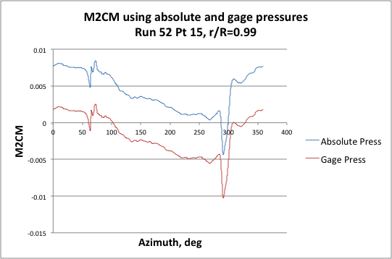
Section Moment Integration Error
PM differences are typically small
Example with largest difference shown (R52P15, r/R=.99)

Slide 10
Mean Lag Comparisons
Two independent systems (crabarm, laser) used to measure blade root motion during WT test
Test data showed blade to blade and method to method differences especially for the mean
Have identified a number of possible causes for the differences (amplifier drift, offsets, RPM/CF effects)
Still evaluating which corrections to apply
Working with analysis, BD, and PIV data to help guide decision

Slide 11
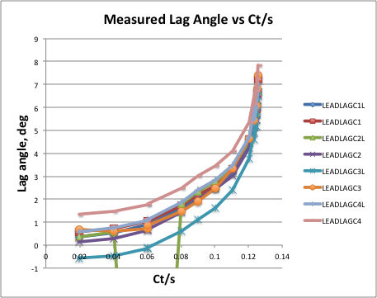
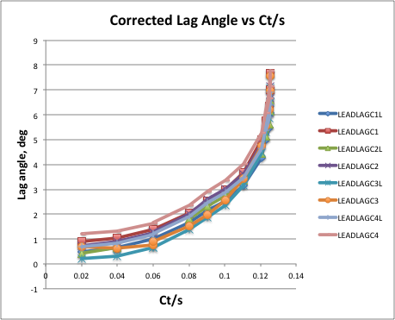
Mean Lag Comparisons
Measured vs Corrected Mean Lag Angle for Thrust Sweep
Reduced scatter (note: corrections are preliminary)

Slide 12
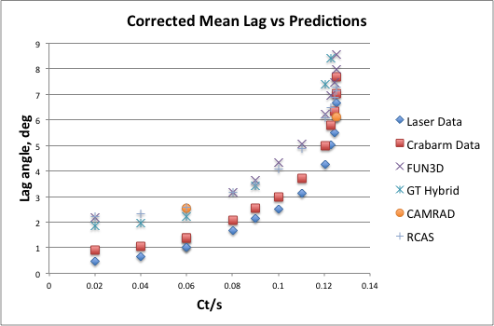
Mean Lag Comparisons
Corrected Mean Lag vs Predictions for Thrust Sweep
Predictions consistently show greater lag than measurements

Slide 13
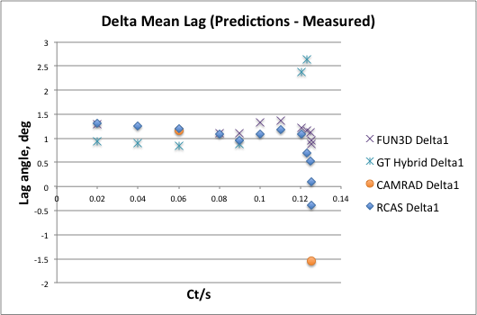
Mean Lag Comparisons
Delta Mean Lag (Predictions – Measured)
Relatively constant offset up to high thrust
Will investigate to determine if this is experimental or analytical error

Slide 14
SignOffPage
Notes:
NASA Presentation Sign-Off Page

